Slide 1
Small Business Conference
San Diego Regional Innovation Cluster
February 25, 2014
The views expressed in this presentation are DCAA's views and not necessarily the views of other DoD organizations

Slide 2
Agenda
8:00-8:05 Introductions - Lou Kelly, Chairman, SDRIC
8:05-8:45 Meet the DCAA Managers - Ron Reichel, DCAA
Senior Financial Liaison Advisor, Camp Pendleton
8:45-9:45 DCAA Pre-award Accounting System Audits - Chiho Ly, Senior Auditor, San Diego Branch Office
9:45-10:00 Break
10:00-11:00 DCAA Provisional Billing Rates/Public Vouchers
Crystal Arnote, Auditor, San Diego Branch Office
Coral Schuster, Senior Auditor, San Diego Branch Office
11:00-11:55 DCAA Incurred Cost Submissions - John Doherty, Regional Audit Manager, Western Region Office
11:55-12:00 Wrap Up - Lou Kelly, Chairman, SDRIC

Slide 3
Overview
DCAA Organization
Meet the Managers
DCAA Initiatives/Changes Affecting Small Business
DCAA Internet Resources/Tools
Elevating Concerns
Subject Matter Presentations

Slide 4
Department of Defense (DoD) Organization
Secretary of Defense
Deputy Sec of Defense
Department
of Army
Procurement
Department
of Navy
Procurement
Department
of Air Force
Procurement
Under Secretary
(A T & L)
DCMA
Under Secretary
(Comptroller)
DCAA
Inspector General

Slide 5
Defense Contract Audit Agency
Approximately 5,000 employees located at over 300 offices throughout the United States and overseas
Responsibilities and Duties:
  Perform all needed contract audits for DoD
  Provide accounting and financial advisory services to DoD (and civilian when requested) acquisition and contract administration components during all contract phases:
    Pre-award
    Contract execution
    Settlement (contract closing)

Slide 6
DCAA Organization
Executive Officer
Joe Garcia
Internal Review
Angela Janysek
Director
Patrick Fitzgerald
Deputy Director
Anita Bales
General Counsel
Defense Legal Service
Susan Chadick
Assistant Director,
Operations
Tom Peters
Assistant Director,
Policy & Plans
Don McKenzie
Assistant Director,
Resources
Philip Anderson
Assistant Director, Integrity &
Quality Assurance
Gary Spjut
Headquarters
Regions
Central
Region
Vacant
Martha McKune
Eastern
Region
David Johnson
Vacant
Northeastern
Region
Ron Meldonian
William Adie
Mid-Atlantic
Region
Ken Saccoccia
Chris Andrezze
Western
Region
Donald Mullinax
Steve Hernandez
Field
Detachment
Karen Cash
Terry Schneider

Slide 7
Financial Liaison Advisor
DCAA's FLAs are auditing professionals assigned to buying commands and are DCAA's principal point of contact at the commands. The FLA's duties range from expediting advisory audit reports to on-the-spot consultation on complex financial and accounting matter related to contract costs.

Slide 8
San Diego Audit Management
Trish Lee - Regional Audit Manager (RAM) Western Region Office
Linda Jung - Branch Manager San Diego Branch Office
Terry Allen – Supervisory Auditor San Diego Branch Office

Slide 9
San Diego Audit Management
John Doherty – Regional Audit Manager Western Region Office – Incurred Cost
Dave Hazlett – Branch Manager San Diego North Incurred Cost Branch
Elizabeth Reynaga – Branch Manager San Diego South Incurred Cost Branch
David Ortiz – Supervisory Auditor San Diego South Incurred Cost Branch

Slide 10
DCAA Initiatives/Changes Affecting Small Business
DFARS threshold changes for proposal audits (DFARS PGI 215.404-2(c))
Pre-award financial condition & forward pricing rates transferred to DCMA
Incurred cost backlog initiative
  Dedicated audit teams
  Low risk sampling
SF1408 Checklist implementation

Slide 11
DCAA Initiatives/Changes Affecting Small Business
Small Business Outreach Initiative
  Website presentations for small business
  Website tools (Checklists, ICE, Etc.)
  Coordination w/ small business contacts at major buying commands (FLAs)
  Participation in seminars/workshops
  NDIA/SBTC joint DCAA/DCMA committee meetings quarterly to discuss small business issues

Slide 12
DCAA Initiatives/Changes Affecting Small Business
Small Business Outreach Initiative (cont.)
  Mandatory auditor small business audit training to Include:
    Background on importance of small business
    General guidance when beginning audit of small business
    Communicating with small business
    Auditing small business – focus on differences between large and small business

Slide 13
Small Business Focal Point
The small business focal point advises the Agency Director on policy issues related to small business concerns, serves as the primary point of contact and source of information, and collects and monitors relevant data regarding the Agency's conduct of audits. The small business focal point's duties are segregated from ongoing audits in the field or any activities that could compromise the independence of the Agency or undermine compliance with applicable audit standards.
Headquarters, Defense Contract Audit Agency
Attn: Operations, Small Business Focal Point
8725 John J. Kingman Road, Suite 2135
Fort Belvoir, VA 22060-6219
Chief, Operations Audit Liaison (937) 255-7789 or DCAA-OAL-SmallBusinessFocalPoint@dcaa.mil

Slide 14
DCAA Internet Resources www.dcaa.mil
Audit Process Overview – Information for Contractors Manual
DCAA Pre-award Accounting System Checklist
DCAA Contract Proposal Adequacy Checklist
DCAA Forward Pricing Rate Adequacy Checklist
DCAA Incurred Cost Adequacy Checklist
Incurred Cost Electronically (ICE) Model
EZ-Quant - Suite of three statistical applications
Links to Acquisition Regulations

Slide 15
Additional DCAA Internet Resources
Small Business Presentations:
  Accounting System Requirements
Real-time Labor Evaluations
Incurred Cost Submissions
Contract Briefs
Provisional Billing Rates
Public Vouchers
Monitoring Subcontracts

Slide 16
Elevating Concerns
If you cannot resolve disagreement or misunderstanding of auditor findings with the auditor and wish to elevate your concerns, we strongly encourage that you do so through the DCAA chain of command.
  First, the supervisor
  Branch Manager
  Regional Audit Manager
  Regional Director

Slide 17
Elevating Concerns
SB focal point cannot change results or direct the audit offices to do anything. Focal point will refer the issue to the Regions for resolution with contractor.
Director will not change results - Regional Directors have oversight of the Regions.
So resolve concerns at lowest level possible
Then the ACO is the deciding official.

Slide 18
DCAA Audits Through Various Phases of a Contract
Pre-Award
Throughout Contract Life
Contract Completed
Accounting System
Estimating System
Proposal Review
- Labor Rates
- Indirect Rates
- Materials
- ODC
Annual Incurred Cost Reviews
Real Time Labor
Provisional Billing Rates
Progress Payments
Vouchers
Accounting System
Contract Closing

Slide 19
Contact Information
DoD Office of Small Business Programs
  www.acq.osd.mil/OSBP
DCAA
  DCAA-OAL-SmallBusinessFocalPoint@dcaa.mill

Slide 20
Preaward
Accounting System
Audits
SDRIC Conference February 25, 2014
The views expressed in this presentation are DCAA's views and not necessarily the views of other DoD organizations

Slide 21
Overview
Purpose of the Preaward Accounting System Audit
Preaudit Activity
SF 1408 Step-by-Step
Exit Conference
Common Deficiencies
DCAA Tools for Contractor Use
Questions and Answers

Slide 22
Purpose of the Preaward Accounting System Audit
Prior to the award of a Government contract, FAR Part 9.104 requires prospective contractors to have:
  adequate financial resources
  adequate accounting system

Slide 23
Purpose of the Preaward Accounting System Audit (cont.)
An examination before contract award requested by the Procuring Contracting Officer (PCO) or cognizant Administrative Contracting Officer (ACO)
Gain an understanding of the design of the prospective accounting system
DCAA will complete a SF 1408

Slide 24
Purpose of the Preaward Accounting System Audit (cont.)
Based on our audit, DCAA will opine as to whether or not the design of the accounting system is suitable for the award of a prospective contract in accordance with FAR 53.209-1(f), Standard Form 1408 (SF 1408), Preaward Survey of Prospective Contractor Accounting System

Slide 25
Preaudit Activity
DCAA or Buying Command will request contractor complete Accounting System Checklist

Slide 26
Preaudit Activity (cont.)
Important because:
  You will become aware of the requirements of an acceptable accounting system
  You are prepared for the audit
  Faster turn around
  Less rework by contractor and auditor
  Quicker contract award

Slide 27
Preaudit Activity (cont.)
Contractor should be prepared to demonstrate how accounting system satisfies SF 1408 criteria at the walkthrough

Slide 28
Preaudit Activity (cont.)
DCAA will request contractor Policies and Procedures
DCAA will request information to complete an Internal Control Questionnaire (ICQ)

Slide 29
SF 1408 Step-by-Step

Slide 30
1. Generally Accepted Accounting Principles
Accrual basis accounting system?
General ledger (G/L) to post costs to?
Ability to generate financial reports?

Slide 31
2.a. Proper Segregation of Direct Costs from Indirect Costs
Policies and Procedures
Chart of Accounts
Demonstrate entering a direct cost and an indirect cost into accounting system

Slide 32
2.b. Identification and Accumulation of Direct Costs by Contract
Will request:
  Profit & Loss (P&L) by Job, Contract, Delivery Order or Contract Line Item Number (CLIN)
  Chart of Accounts
  Contractor’s proposal

Slide 33
2.c. Allocation of Indirect Costs
Contractor proposal
Indirect rate sheets
Documented bases and pools
Written Policies and Procedures

Slide 34
2.d. Accumulation of Costs under G/L Control
Can the P&L by Job reconcile to the G/L control accounts?
How often are costs posted to the G/L?
Policies and Procedures

Slide 35
2.e. Timekeeping System
Policies and Procedures
Timekeeping document (paper or electronic timecards)
Timecards completed and certified by the employees
Timecards approved by the employees’ supervisors.
When are timesheets filled out
Reconcilable labor cost distribution records
Who monitors the timekeeping system and how often

Slide 36
2.f. Labor Distribution System
Policies and Procedures
  Labor Distribution → Payroll Register
  Labor Distribution ←→ P&L by Job
Who Monitors and How Often

Slide 37
2.g. Interim Determination of Costs
What is the process for posting costs?
  Responsible personnel
  Frequency

Slide 38
2.h. Unallowable Costs
Policies and Procedures
What is an unallowable cost – FAR Part 31.205
How will unallowable costs be identified AND excluded
Who and how often will unallowable costs be monitored
Chart of Accounts which identifies unallowable accounts

Slide 39
2.i. Costs by Contract Line Item
Contractor’s proposal
Who creates new jobs in the system
How is the level of contract information communicated to the person creating the new job in the system

Slide 40
2.j. Segregation of Preproduction Costs from Production Costs
Policies and Procedures
Chart of Accounts with unique preproduction project numbers
Can costs be accumulated for a specific timespan

Slide 41
3.a. Limitation of Costs
Policies and Procedures
Proposal’s rate calculation sheet
Procedure for contract briefs
Billing template
Who and how often are total contract expenditures monitored against contract limitations

Slide 42
3.b. Billings
Policies and Procedures
Invoice example with current and cumulative amounts
How will invoice reconcile to the P&L by Job or G/L by cost elements
Timing of vendor and subcontractor payments

Slide 43
Exit Conference
Results of Audit
  Yes
  Yes, with a recommendation that a follow on accounting review be performed after contract award
  No

Slide 44
Common Deficiencies
Narrative on the Accounting System Checklist – Incomplete or uses simple definitions without the how (who, what, when)
No written pool and base descriptions
Excel ‘timecards’ which are changeable, unsigned, and uncertified

Slide 45
Common Deficiencies (cont.)
Not routinely posting to books of account (at least monthly)
Lack of process to monitor
Lack of understanding of what is unallowable FAR Part 31.205

Slide 46
Common Deficiencies (cont.)
Billing the Government for cost when payment to subcontractor or vendor will NOT be made in accordance with terms and conditions of the subcontract or invoice and ordinarily within 30 days of the contractor’s payment request to the Government.
No process to brief contracts

Slide 47
Common Deficiencies (cont.)
Chart of Accounts with numbers only and no account description
Invoices do not show both current and cumulative amounts
Unable to create P&L at level of detail required by RFP

Slide 48
DCAA Tools for Contractors
SF 1408
Preaward Checklist
Information for Contractors
FAR Part 31.205 – Unallowables
Preaward Accounting Audit Program
Contract Audit Manual (CAM)

Slide 49
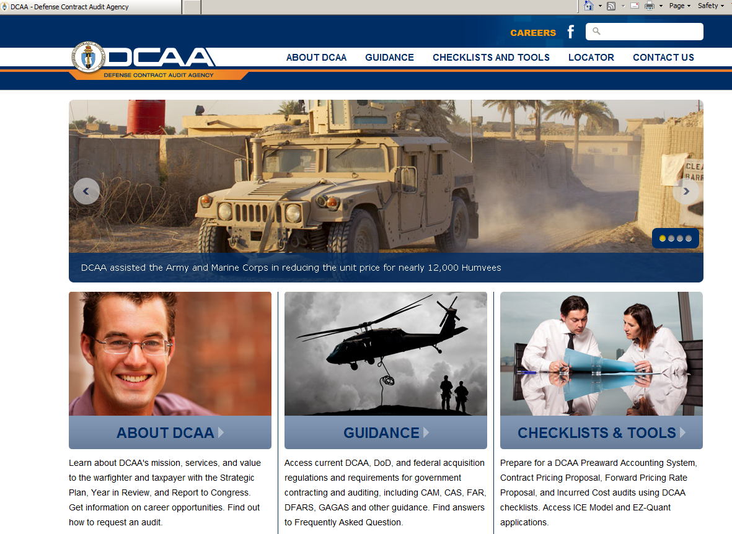
DCAA Public Website http://www.dcaa.mil/

Slide 50

What NOT to Do!
http://dcaa.mil/

Slide 51
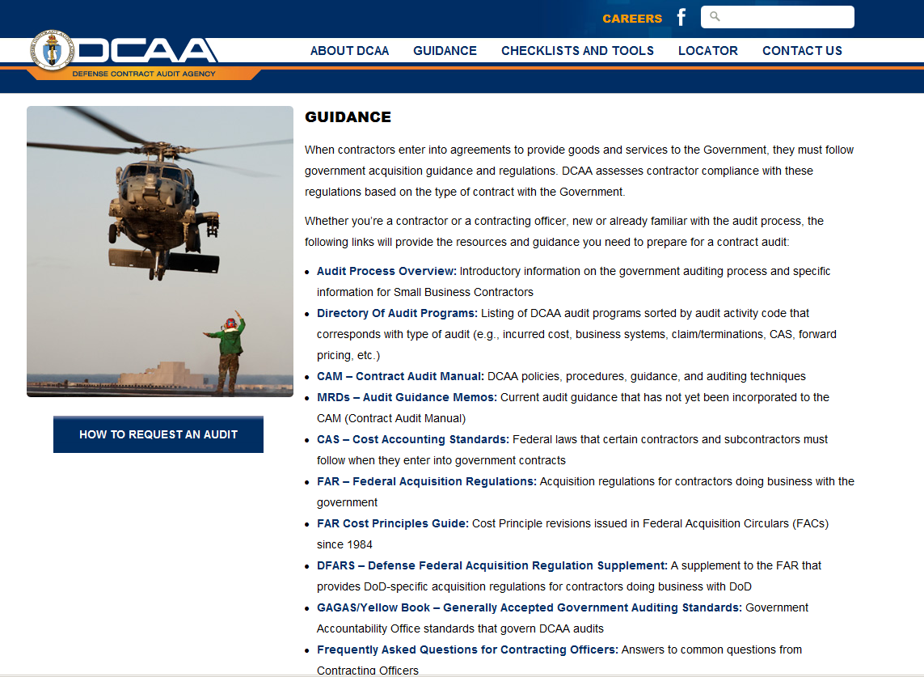
DCAA Public Website http://www.dcaa.mil/

Slide 52
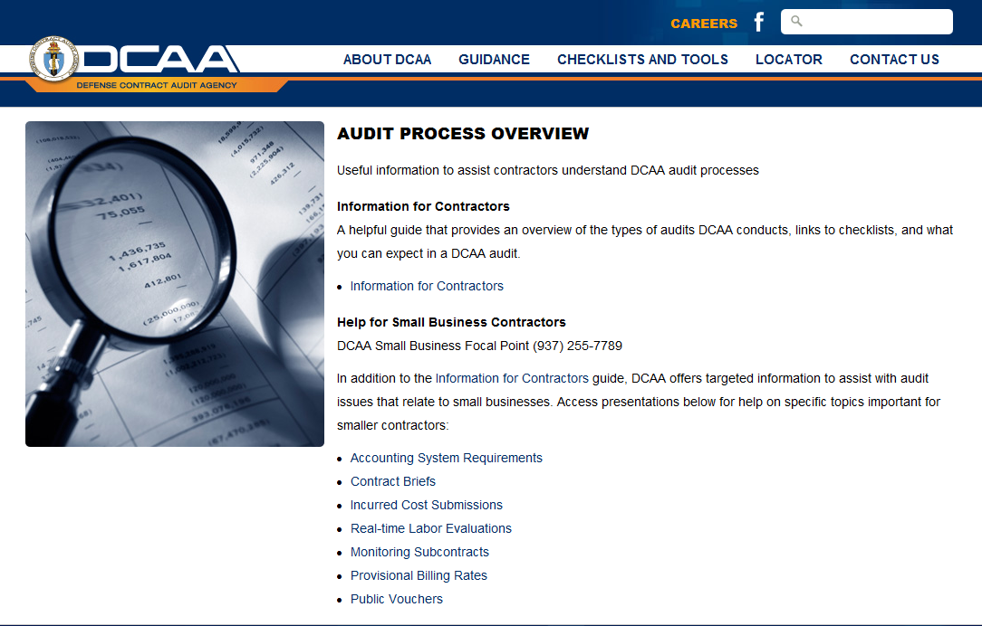
DCAA Public Website http://www.dcaa.mil/

Slide 53
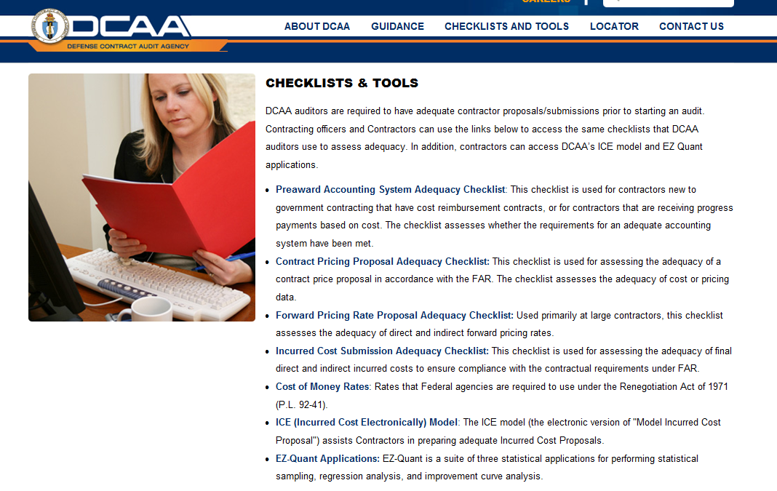
DCAA Public Website http://www.dcaa.mil/

Slide 54
Participant Questions
How to schedule a preaward audit? What is the cost of a preaward audit?
How long does the preaward audit last?
My company did not receive a pre-audit verification even though we paid an accounting firm a great deal of money.

Slide 55
Participant Questions
If a small business has not been tasked does the audit expire?
Is providing payroll data to DCAA related to a proposal count as an audit?
We just won our Seaport-e IDIQ contract. Does DCAA plan on auditing our accounting system?

Slide 56
Participant Questions
The current pre-award accounting system audit covers 12 of the 18 criteria for a business system audit as required by DFARS 252.242.7006(c). When can a covered contractor expect to have a DCAA audit the remaining 6 criteria?
With all the new auditors, will DCAA enhance its training?

Slide 57
Provisional Billing Rates and Public Vouchers
SDRIC Conference February 25, 2014
The views expressed in this presentation are DCAA's views and not
necessarily the views of other DoD organizations

Slide 58
Overview
Provisional Billing Rates (PBRs)
  Procedures for Establishing PBRs
  When & What to Submit
  DCAA Review
  Monitoring
Public Vouchers
  Contractor Responsibilities
  Wide Area Workflow (WAWF)
Common Deficiencies
Frequently Asked Questions

Slide 59
Provisional Billing Rates

Slide 60
Establishing Billing Rates
FAR 42.704(b)
The contracting officer (or cognizant Federal agency official) or auditor shall establish billing rates on the basis of information resulting from recent review, previous rate audits or experience, or similar reliable data or experience of other contracting activities. In establishing billing rates, the contracting officer (or cognizant Federal agency official) or auditor should ensure that the billing rates are as close as possible to the final indirect cost rates anticipated for the contractor’s fiscal period, as adjusted for any unallowable costs. When the contracting officer (or cognizant Federal agency official) or auditor determines that the dollar value of contracts requiring use of billing rates does not warrant submission of a detailed billing rate proposal, the billing rates may be established by making appropriate adjustments from the prior year’s indirect cost experience to eliminate unallowable and nonrecurring costs and to reflect new or changed conditions.

Slide 61
Purpose of PBRs
Used for interim billing during the contractor’s fiscal year
Established to approximate the contractor’s final year- end rates
Billings should be reconcilable to the cost accounts for both current and cumulative amounts claimed and comply with contract terms
Note: PBRs are ONLY for use in provisional billing. They are NOT for use in bidding/forward pricing or final indirect rates.

Slide 62
Reasons for Contractor Submission
Contractors are STRONGLY encouraged to submit a billing rate proposal to assist the responsible official in establishing rates
Opportunity to present and explain expected changes
Note: Vouchers and progress payments may be REJECTED if submitted without using properly established billing rates

Slide 63
When to Submit?
PBRs should be submitted at least annually
  PRIOR to the BEGINNING of contractor fiscal year
  AND
  When established billing rates no longer represent expected final year end rates due to unforeseen events/circumstances
Note: The PBR submissions should represent the contractor’s entire fiscal year

Slide 64
What Should Be Provided?
Letter stating the proposed rates and period covered
Proposed billing rate calculations (Pool and Base) with brief rationale
Prior fiscal year (FY) pool and base
Current FY to date pool and base
Pool and base projection for remainder of current FY
Upcoming FY budget pool and base, if available
Comparative analysis with explanation of any significant differences

Slide 65
DCAA Review
DCAA may perform the following procedures:
  Compare proposed pool and base to prior year and year-to-date pool and bases
  Compare proposed pool/base/rates to those submitted on incurred cost submission
  Review trend of questioned costs in relevant incurred cost audits and consider an adjustment for unallowable expenses in calculating current year provisional billing rates

Slide 66
Contractor Self-Monitoring
Periodically throughout the year
  Throughout the year
  Immediately after year-end
  Upon submission of the final indirect rate proposal
PBRs may be adjusted by either party at any time to prevent substantial under or over payment – FAR 42.704(c).
If PBRs are adjusted, the contractor should submit adjustment vouchers accordingly

Slide 67
Adjustment
  Submit a letter with new rates, an explanation as to what caused the change, and with supporting data
If DCAA/DCMA has NOT issued a memo:
  Begin using the new rates immediately
If DCAA/DCMA HAS issued a memo:
  Continue using the rates as listed on the memo unless you receive a new memo from DCAA/DCMA
    Please contact your cognizant office if you have concerns
NOTE: If PBRs are adjusted, use the new rate on the current year cumulative expenses

Slide 68
Common Deficiencies
Waiting until completion of the final indirect rate proposal to submit proposed PBR
Unable to support proposed significant rate changes
Delayed response to DCAA information requests

Slide 69
Common Deficiencies
Consistent over/under estimations
Using PBR as proposal rates for potential contracts
Not using correct PBRs on vouchers
If a contract outlines a set of maximum indirect rates a PBR MUST still be established

Slide 70
Common Deficiencies
Failure to remove unallowable costs from the billing rate projections
Failure to adjust provisional billing rates based on actual experience:
  Before year end, if there are known or reasonably anticipated significant variances
  After year end once actual rates, net of unallowable expenses, are calculated

Slide 71
Public Vouchers

Slide 72
Overview
Cost type contracts provide for interim payments for costs on a cost voucher. DCAA will perform voucher reviews based on risk.
Fixed price contracts are subject to FAR Part 32 financing methods (progress payments).

Slide 73

Contractor Responsibilities
Contact cognizant DCAA office after contract award
Ensure DCAA has the necessary information to process contract billings
  current provisional billing rates
  copy of contract brief (include special contract provisions)
Maintain adequate billing system internal controls
Maintain adequate support for amounts billed
Submit timely incurred cost proposals and final vouchers in accordance with FAR 52.216-7

Slide 74
Adequate Billing System
Adequate accounting system
Established billing rates with timely adjustments to reflect year end allowable costs
Vouchers must be based on established billing rates
Contracts are briefed by contractor to ensure vouchers accurately reflect special cost limitations and other contract restrictions

Slide 75
Adequate Billing System
Interim vouchers prepared directly from cost accounting records
Adequate incurred cost proposals are submitted timely
Maintains a Cumulative Allowable Costs by Contract worksheet
Final vouchers submitted in accordance with FAR 52.216-7

Slide 76
Preparation of Vouchers
Contractor is responsible for preparing and submitting claims for reimbursement according to the terms of the contract
Vouchers should not be submitted more than once every two weeks
Public voucher claims for reimbursement must be submitted via Wide Area Workflow (WAWF):
  First voucher on a contract is an interim voucher, as are all subsequent vouchers prior to the final voucher
  Final voucher will not be submitted until all contract work is completed

Slide 77
Wide Area Workflow (WAWF)
  DFARS 252.232-7003 REQUIRES the use of WAWF as the primary system for submission and processing of payment requests.

Slide 78
Wide Area Workflow (WAWF)
Includes a voucher sampling approach that replaces the direct bill program
DFARS 242.803 gives DCAA authority to:
  Approve interim vouchers selected using sampling methodology for provisional payment and forward to the disbursing office
    ALL provisionally approved interim vouchers are subject to a later audit of actual costs incurred
  Review final vouchers and send to the Administrative Contracting Officer (ACO)

Slide 79
Submission of Interim Vouchers
Vouchers must be prepared and submitted in accordance with the terms of the contract, including any special billing/payment instructions
  All vouchers should be submitted in WAWF unless contract terms require submission of hard copy vouchers
  Guidance/training for completing cost vouchers can be found on the WAWF website: https://wawf.eb.mil
In WAWF, the “Cost Voucher” is the equivalent of the SF 1034
  Data equivalent to the SF 1035 must be included in an electronic file and uploaded to WAWF

Slide 80
Submission of Interim Vouchers
Required information and examples can be found in DCAA Manual 7641.90, Information for Contractors, pages 46 – 49 at: http://www.dcaa.mil/DCAAM_7641.90.pdf
Required information includes:
  Contract Number and Delivery/Task Order
  Contract Costs and Fixed Fee
  Identify Fee Withholding Threshold

Slide 81
Submission of Interim Vouchers
Required information includes (cont.):
  Current and Cumulative Costs Billed
  Breakdown by Major Cost Element (i.e., Labor, Materials, Overhead)
  Fee Earned And Due
  Total Claimed Amount
  Adjustments (i.e., Withheld Fee, Excess Costs Incurred)
  Total Voucher Amount

Slide 82
Submission of Adjusting Vouchers
Adjusting voucher:
  Addresses changes to billing rates during or after year-end
  Can be on a separate voucher or combined with interim voucher

Slide 83
Submission of Final Vouchers
Last voucher to be submitted on a contract
A separate completion voucher will be submitted for each individual project or task order for which a separate series of public vouchers has been submitted
In accordance with FAR 52.216-7(d)(5).

Slide 84
Common Deficiencies
Billing to incorrect DODAAC
Math errors
Billed costs not allowed per the contract terms (e.g., overtime)
Not billing in accordance with contract terms:
  Fixed-fee
  Funding & Cost Ceilings

Slide 85
Common Deficiencies
Incorrect provisional billing rates (indirect costs)
Billing rates not adjusted to year-end actual rates
Inability to provide sufficient supporting documents in a timely manner

Slide 86
Frequently Asked Questions
Question: How do I know what DCAA office is my cognizant office?
Response: Visit www.dcaa.mil/office_locator.html, search by CAGE Code, DUNS Code, or ZIP Code.

Slide 87
Frequently Asked Questions
Question: Do I submit the Provisional Billing Rate Proposal to the ACO or DCAA Office?
Response: FAR 42.704 states the office responsible for final indirect cost rates also establishes provisional billing rates

Slide 88
Frequently Asked Questions
Question: Can I just use the most recent FY end rates for provisional billing purposes?
Response: No

Slide 89
Frequently Asked Questions
Question: Once provisional billing rates are established with DCAA or the ACO, do I need to submit proposed changes based on new information?
Response: Yes

Slide 90
Frequently Asked Questions
Question: Is there any general guidance for how a contractor should be inputting information into WAWF?
Response: Yes
https://wawftraining.eb.mil/xhtml/unauth/web/wbt/
wawfra/vendor/DocumentCreate.xhtml

Slide 91
Frequently Asked Questions
Question: When information is incorrect on a voucher, can the contractor recall/correct the voucher or does a new voucher have to be submitted?
Response: Contractors cannot correct the following fields on submitted vouchers: contract number, delivery order number, Cage Code, document type, shipment number/date, and voucher number/date.
Recalling or Resubmitting Invoices Quick Reference guide:
http://www.dtra.mil/documents/business/wawf/RecallorResubmit.pdf

Slide 92
Participant Questions
What is the process a new contractor should follow to obtain DCAA approved PBRs?
What marketing/business development activities are allowed in the rate computation?

Slide 93
Participant Questions
How does the progress invoice type work in WAWF?
How does the MOCAS information sharing work?
How do I submit the portion of the invoice that was not accommodated for in the original submission?

Slide 94
Resources
Information regarding WAWF is available on the Internet at https://wawf.eb.mil/.
Additional Information and Links:
  WAWF Training & Practice: https://wawftraining.eb.mil
  Help guides: http://www.dfas.mil/ecommerce/wawf/info.html
  DFAS (To check invoice payment status):
    myInvoice: https://myinvoice.csd.disa.mil//index.html
  Information for Contractors Manual (Enclosure 5): http://www.dcaa.mil

Slide 95
Incurred Cost Submissions
SDRIC Conference February 25, 2014
The views expressed in this presentation are DCAA's views and not necessarily the views of other DoD organizations

Slide 96
Incurred Cost Submissions
Due Dates of Submissions
Delinquent Submissions
Adequacy Review
Audit Requirements
Required Submission Schedules
ICE Model
Penalties
Frequently Asked Questions
96

Slide 97
Due Dates of Submissions
Incurred cost claims are due six months after completion of the contractor’s fiscal year end.
  Per the Allowable Cost and Payment Clause (FAR 52.216-7(d)(2))
  Allowable cost and payment clause applies to cost-reimbursement type contracts (FAR 16.307)
97

Slide 98
Delinquent Submissions
If submissions are six months delinquent, DCAA will recommend a decrement factor and for the CO to make a unilateral determination. (FAR 42.703-2(c)(2))
98

Slide 99
Incurred Cost Adequacy Review
We check for the schedules listed FAR 52.216-7(d)(2)(iii)
Any missing or unreconcilable schedule could cause us to report the submission as inadequate.
Recommend self-assessment
http://www.dcaa.mil/incurred_cost_checklist.html
99

Slide 100
Audit Requirements
FAR 31.201-2 (d) Requires contractors to maintain records and supporting documentation to demonstrate allowability and allocability of costs.
FAR 31.205 also requires specific documentation to demonstrate the allowability of certain cost elements
100

Slide 101
Examples of Specific Documentation
Under FAR 31.205
FAR 31.205-33, Professional and Consultant Service Costs, requires the following evidential matter:
  Details of all agreements (e.g., work requirements, rate of compensation, and nature and amount of other expenses, if any) with the individuals or organizations providing the services and details of actual services performed;
  Invoices or billings submitted by consultants, including sufficient detail as to the time expended and nature of the actual services provided; and
  Consultants’ work products and related documents, such as trip reports indicating persons visited and subjects discussed, minutes of meetings, and collateral memoranda and reports.
101

Slide 102
Examples of Specific Documentation
Under FAR 31.205
FAR 31.205-46, Travel Costs indicates costs shall be allowable only if the following information is documented:
  Date and place (city, town, or other similar designation) of the expenses;
  Purpose of the trip; and
  Name of person on trip and that person’s title or relationship to the contractor
102

Slide 103
ICE MODEL
ICE is an EXCEL spreadsheet that provides contractors with a standard user-friendly electronic package to assist in preparing timely and adequate incurred cost submissions.
It should result in less time being spent in:
  Submission preparation.
  Supporting the audit.
103

Slide 104
ICE BENEFITS
    User Friendly
    It includes all schedules required for an adequate submission per FAR 52.216-7
    Updates are performed electronically and the linking feature updates all impacted schedules.
    ICE creates an inventory of electronic files that can be used in subsequent years to compare costs and facilitate submission preparation.
    The submission of an adequate proposal may expedite contract closings.
104

Slide 105
Required Information in Incurred Cost Submission FAR 52.216-7(d)(2)(iii) (referenced to ICE model)
Schedule A Summary of Indirect Expense Rates
Schedule B, C, D Indirect Cost Pools
Schedule E Claimed Allocation Bases
Schedule F Cost of Money
Schedule G Booked and Claimed Direct Costs
Schedule H Direct Costs by Contract at Claimed Rates
Schedule H-1 Government Participation by Pool
Schedule I Cumulative Allowable Cost Worksheet
Schedule J Subcontract Information
Schedule K Hours and Amounts on T&M Contracts
Schedule L Payroll Reconciliation
Schedule M Accounting/Organization Changes
Schedule N Certificate of Indirect Costs
Schedule O Contract Closing Information
105

Slide 106
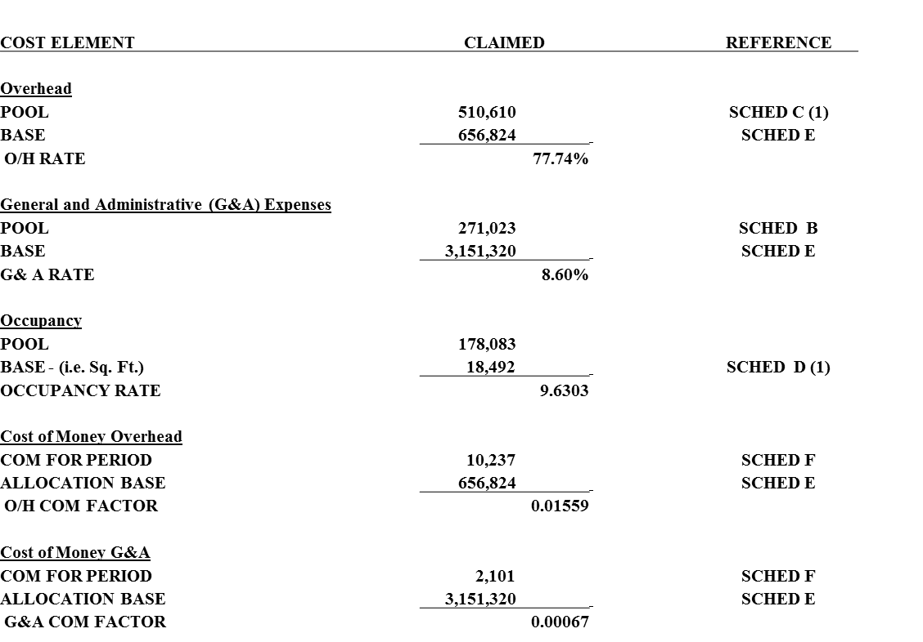
Schedule A
Summary of Indirect Expense Rates
106

Slide 107
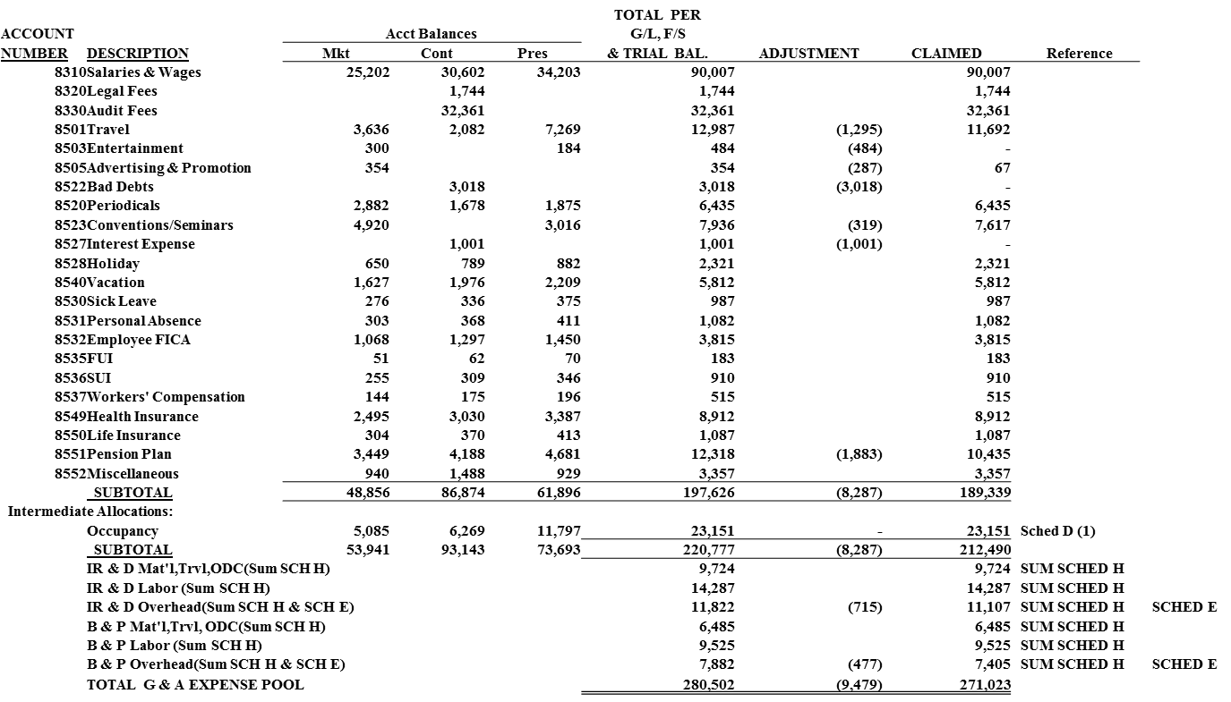
Schedule B, C, D—Indirect Cost Pools
107

Slide 108
Schedule E—Claimed Allocation Bases
108

Slide 109
Schedule F—Facilities Cost of Money
109

Slide 110
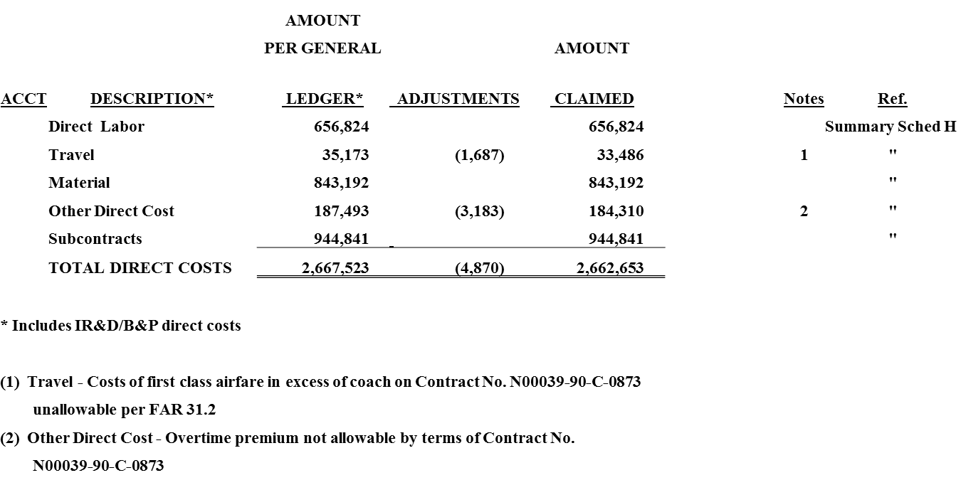
Schedule G—Booked and Claimed Direct Costs
110

Slide 111
Schedule H—Direct Costs by Contract at Claimed Rates
111

Slide 112
Schedule H-1—Government Participation
112

Slide 113
Schedule I—CACWS
113

Slide 114
Schedule J—Subcontract Information
114

Slide 115
Schedule K—Hours and Amounts on Time and Material (T&M) Contracts
115

Slide 116
Schedule L—Payroll Reconciliation
116

Slide 117
Schedule M—Accounting/Organization Changes, etc.
This schedule provides information to the auditor related to the following:
  Significant decisions, agreements or approvals (e.g. pension plan, billing rates or contract ceilings)
  Significant accounting or organization changes (e.g. changes to indirect pool structure or mergers and acquisitions)
117

Slide 118
Schedule N—Certificate of Indirect Costs
118

Slide 119
Schedule O—Contract Closing Info
119

Slide 120
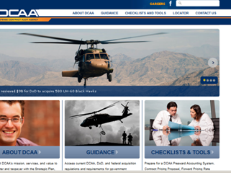
DCAA website
120

Slide 121
EXPLORING ICE MODEL
ICE MANUAL.DOC
Complete Instructions for Using the ICE Model
121

Slide 122
EXPLORING ICE MODEL
Includes Two Excel Files :
ICE_Model(2.0.1c).xls - Template for Use
in Preparing Incurred Cost Proposal
ICE_Demo(2.0.1c).xls – Sample File with Data
122

Slide 123
Other Schedules Provided by ICE
The ICE program provides the following additional Schedules:
  Computation of Allowable IR&D/B&P costs (usually only applicable to major contractors)
  Comparative Analysis by pool and account
  Reconciliation of claim to corporate income tax return
  Contract Brief
  Executive Compensation form
123

Slide 124
Penalties (FAR 42.709):
Penalties will be assessed if a contractor claims an expressly unallowable indirect costs (as noted in FAR 31.2) in an incurred cost submission
Two levels of penalties
124

Slide 125
Common Deficiencies:
Signed certification not included or not signed by at least a Vice President or CFO (schedule N)
Lack of subcontractor information (schedule J)
Not all intermediate allocations disclosed (sch. D)
Unallowable costs not included in G&A base (sch. E)
IR&D/B&P not fully burdened (sch. B)
Physically complete contracts not shown on sch. I & O
Government participation not calculated for all final indirect rates (schedule H-1)
125

Slide 126
Frequently Asked Questions:
Do I have to use the ICE model?
  No, contractor may use any format; However, the ICE model does provide all the schedules required per FAR 52.216-7
126

Slide 127
Frequently Asked Questions:
Can DCAA grant an extension for submitting my final incurred cost rate proposal?
  No. Extensions for submitting final rate proposals can only be granted by the administrative contracting officer per FAR 42.302 and FAR 42.705-1(b)(1)(ii). To locate your responsible administrative contracting officer, please contact the Defense Contract Management Agency (DCMA).
127

Slide 128
Frequently Asked Questions:
When will DCAA determine adequacy of my incurred cost submission and perform the incurred cost audit?
  Auditors should evaluate a contractor’s incurred cost proposal upon receipt and immediately notify the contracting officer of significant deficiencies.
  It is DCAA policy that indirect submissions will be audited as promptly as possible after receipt.
128

Slide 129
Frequently Asked Questions:
I’m preparing my submission(s) (e.g. contract pricing proposal, forward pricing rates, incurred cost, etc.) and would like to ask the DCAA auditor some specific questions on my submission to make sure I’m on the right track. Will the DCAA auditor give me some specific advice on how to prepare my submission?
  Answer: A DCAA auditor can answer general questions related to the acquisition regulations. For example, if a contractor asked advice on what the FAR requires in certain situations, a DCAA auditor would be able to provide that information. Auditors may also provide general advice on what constitutes an adequate submission. However, auditors are precluded from assisting contractors in preparing and developing the contractor’s submission because doing so would create a significant threat to the auditor’s independence. Contractors should look under the “Guidance” and “Checklist and Tools” tabs on DCAA’s website for guidance about the adequacy of their specific submission.
129

Slide 130
Questions?
130

